Slide 1
Business Case : HealthCare
EXL Excellence Quotient 2016

Slide 2
Background:
Worldwide, COPD affects 329 million people or nearly 5 percent of the population.
Exacerbations of COPD contribute to lung function decline and reduced quality of life
It leads to significant increases in resource utilization and cost to the health care system. COPD patients with chronic bronchitis and a history of exacerbations pose an additional burden to the system
Early recognition of exacerbations and prompt treatment have shown to ameliorate recovery while improving health-related quality of life and reducing the risk of hospital admission.
Task:
Using predictive models, descriptive statistics and innovative graphical displays, explore the dataset of COPD patients, and identify factors that appear to influence the Exacerbations of Chronic Obstructive Pulmonary Diseaese
Data:
60 Columns of medically derived data broadly divided into following broad categories
Demographic Variables - Age, Gender, Height, Weight, Nationality
History of Lung Problems – Cough, Asthama etc
History of Lung Disease Symptoms
Smoking Habits
Questionnaire on Overall well being
Lung Functions derived by Spirometry – FEV1,FVC etc.

Slide 3
The first step in analysis was to look at the class of the variables. The target variable was categorical having two levels, while the predictor variables were a mix of continuous, categorical and ordered categorical.
We began our analysis by looking at the continuous variables and then we resorted to categorical and ordered categorical variables
Our Analysis Procedure can be summarized as follows:
Step1: Univariate Analysis
Distributions of some of the variables like Demographic variables were roughly normal while distributions of some of the
Lung Function Variables were skewed. It was done just for the purpose of understanding data and plots have not been
Included in the presentation.
Step2: Analysis wrt Target Variable
This yielded several variables which were discriminative between exacerbator and non-exacerbator population like
ResQues1, ResQues1a etc., while some of the variables were impartial between classes. However these variables were not
removed and kept for modelling in case they form something useful in combinations with other predictors.
Step3: Multivariate Analysis
Analysis of two or more variables together with respect to target population. Multivariate Plots became complex however
some of the plots yielded very useful information.
Step4: Modelling
Step5: Model Analysis
Step5: Results Analysis
Step6: Misclassification Reasons Analysis
All the Visualizations are summarized in subsequent slides.

Slide 4
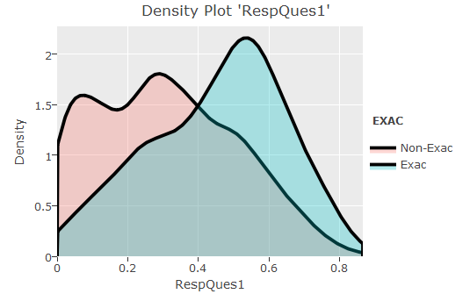
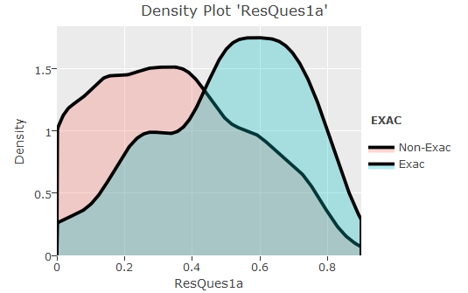
BIVARIATE ANALYSIS
Density Plots of Continuous Predictors with respect to target variable tells us that some variables like “RespQues1”, “Dis2Times”, “LungFun1” etc. were discriminative between exacerbator and non-excaerbator population.
DISCRIMINATIVE PREDICTORS
LESS OVERLAPPED
DISTRIBUTION

Slide 5
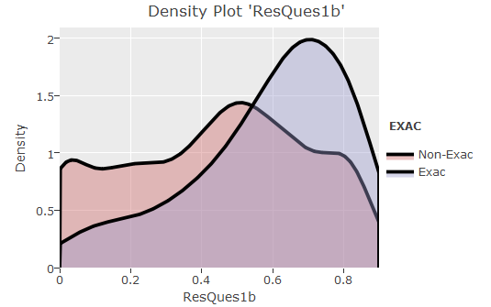
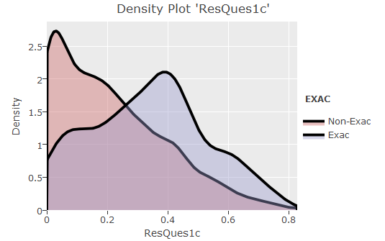
DISCRIMINATIVE PREDICTORS
LESS OVERLAPPED
DISTRIBUTION

Slide 6
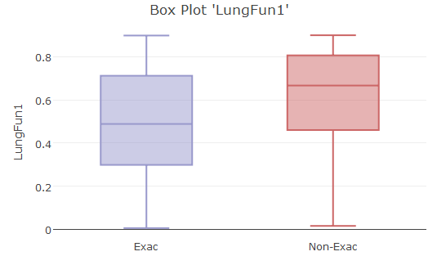
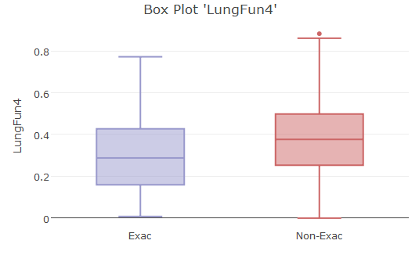
DISCRIMINATIVE PREDICTORS
LESS OVERLAPPED
BOXPLOTS

Slide 7
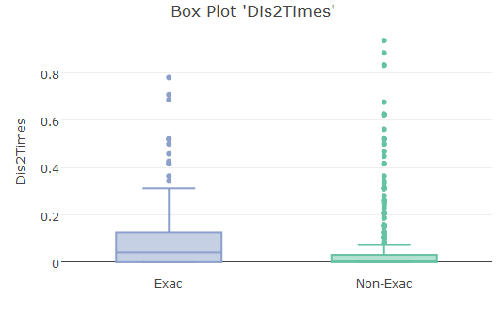
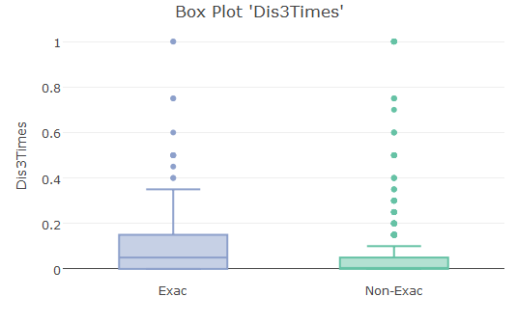
DISCRIMINATIVE PREDICTORS
LESS OVERLAPPED
BOXPLOTS

Slide 8
We can also analyse the continuous predictors by binning them into several groups and calculating the percentage of eaxcerbator and non-exacerbator population in each group. If the bins have significant difference in percentage, the predictor is discriminative
DISCRIMINATIVE PREDICTORS
VARYING PERCENTAGE OF EXACERBATION POPULATION
IN DIFFERENT BINS

Slide 9
DISCRIMINATIVE PREDICTORS
VARYING PERCENTAGE OF EXACERBATION POPULATION
IN DIFFERENT BINS

Slide 10
Moving on to categorical predictors, Variables named DisHis had significantly different percentage of exacerbator population in different levels and hence were discriminative between target classes
DISCRIMINATIVE PREDICTORS
VARYING PERCENTAGE OF EXACERBATION POPULATION
IN DIFFERENT LEVELS

Slide 11
DISCRIMINATIVE PREDICTORS
1
0

Slide 12
We had two ordered categorical predictors namely “DisStage1” and “DisStage2”. It is worthwhile to note that the odds of exacerbation increased as the severity increased.
INCREASING ODDS OF EXACERBATION WITH INCREASE IN SEVERITY
NOTE: Levels in DisStage 2 were reduced for better visualization, however it was ensured it remained ordered categorical

Slide 13
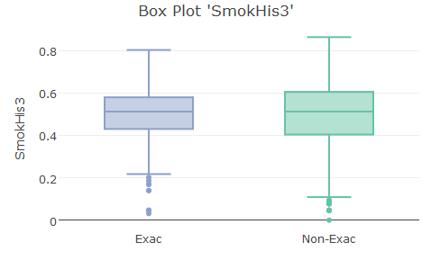
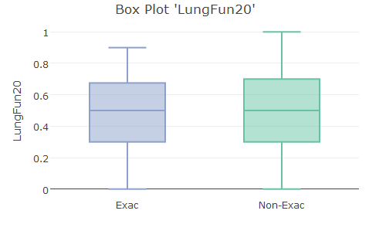
While some of the predictors were discriminative between classes, Demographic Variables, Variables related to Smoke Habits and some Lung Functions were impartial. Some of the impartial predictors which were unable to distinguish between classes on their own have been plotted here.
IMPARTIAL PREDICTORS
COMPLETELY OVERLAPPED BOXES

Slide 14
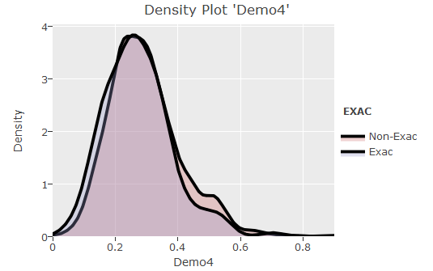
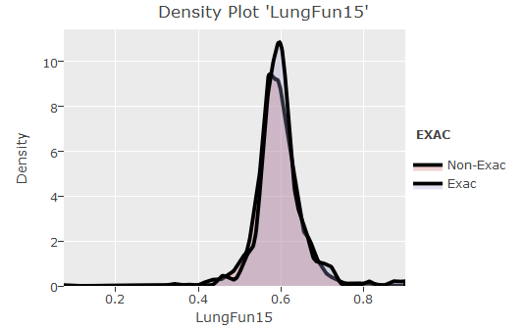
IMPARTIAL PREDICTORS
COMPLETELY OVERLAPPED DISTRIBUTIONS

Slide 15
IMPARTIAL PREDICTORS
ALMOST SAME PERCENTAGE OF EXACERBATION POPULATION
IN DIFFERENT LEVELS

Slide 16
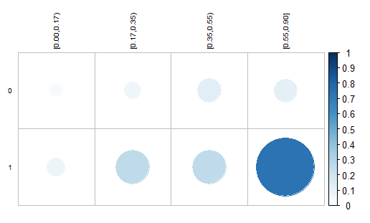
We tried to consider two predictors at a time and see how they combine to differentiate between two target classes. Combination of predictors became better differentiators that the individual predictors themselves. For the purpose of Visualization, continuous predictors were binned.
ResQues1a
MULTIVARIATE ANALYSIS
DisHis3
We can see that one of the levels of combination gives odds nearly equal to 1. It shows that more variables can be combined to get even better odds.
“Odds of Exacerbation” in different levels of combination of “DisHis3” and “ResQues1a”

Slide 17
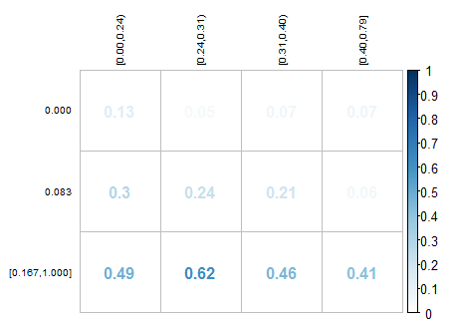
Demo6
Combination of Demo6 and DisHis2Times yields another interesting thing, while Demo6 is not a discriminating variable by itself. On being combined with DisHis3 it betters the performance of DisHis2Times.
DisHis2Times
“Odds of Exacerbation” in different levels of combination of “Demo6” and “DisHis2Times”

Slide 18
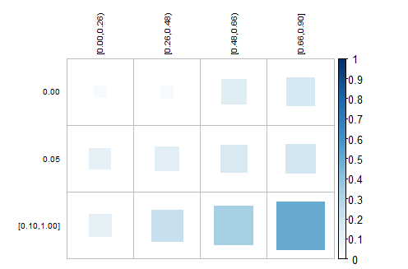
ResQues1b
Combination of Dis3Times and ResQues1b make a better discriminative variable than they both individually were
Dis3Times
“Odds of Exacerbation” in different levels of combination of “Dis3Times” and “ResQues1b”

Slide 19
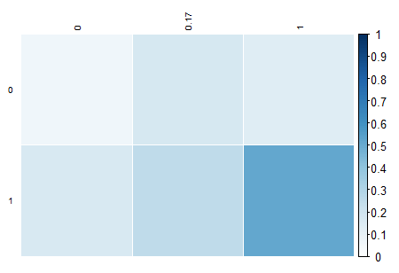
DisHis6
Combination of DisHis2 and DisHis6 make a better discriminative variable than they both individually were. Also we see an almost linear increase in odds from going top-left to bottom-right
DisHis2
“Odds of Exacerbation” in different levels of combination of “DisHis2” and “DisHis6”

Slide 20
Odds of Exacerbation increase almost linearly with Combination of LungFun3 and ResQues1a

Slide 21
COMPARING OUR RESULTS WITH FACTS ABOUT COPD
Since the variables were unnamed to protect anonymity we could not specifically cross check our findings with the facts about COPD. However we were able to compare our results broadly.
In our analysis we saw that Responses of Questionnaire were an important factor in exacerbation risk prediction. During our study about COPD we found out that a questionnaire called CAT (COPD Assessment Test) is so important the doctors actually use CAT Scores in diagnosis of COPD.
Some Lung Functions were judged very important by our analysis. Since COPD is a pulmonary disease,there is no reason as to why Lung Functions should not be important in risk prediction. In fact, On the basis of some Lung Functions like FEV1 and FVC, GOLD Stage of a patient in determined, which is a measure of severity of Chronic Obstructive Pulmonary Disease (Reference : http://www.webmd.com/lung/copd/gold-criteria-for-copd)
Comorbidities (Other lung ailments, named Dis2, Dis3 etc. in our data) were not very important in our analysis. In our analysis severity of COPD has very little to do with other lung ailments. However, Symptoms (named DisHis1, DisHis2 etc. in our data) were an important factor in risk prediction also Smoking Habits were somewhat important in our analysis. These conclusions were consistent with some of the publications of International Journal of COPD.

Slide 22
NEED FOR MACHINE LEARNING MODELS
We tried to visualize the combination of three or more variables wrt target classes, but the plots became less nicer and less meaningful. So we handed the data over to machine learning models to find better combinations .

Slide 23
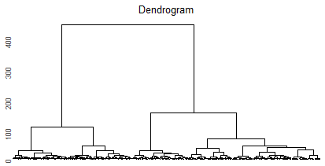
UNSUPERVISED LEARNING
We tried to use unsupervised techniques to split the data into two groups. Even without labels the two groups by themselves had significant differences in percentage of Population with Exacerbation. Modelling for these two Clusters separately improve the metric “Root Mean Square Error” by some extent.
Also It was interesting to know that the most stable number of cluster groups in the data was 2 as shown by the dendrogram.
Another popular unsupervised learning technique “pca” was also applied. Out of 60 odd variables , pca captured 95% of variance in just 33 variables almost halving the dimension, However this came at a cost to “rmse” and hence we decided to keep our original variables instead of using pca components

Slide 24
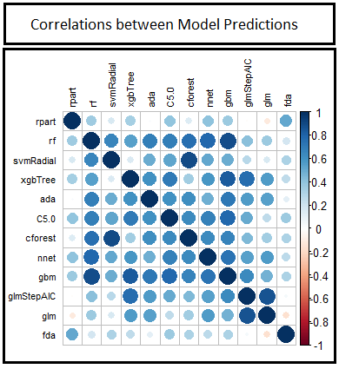
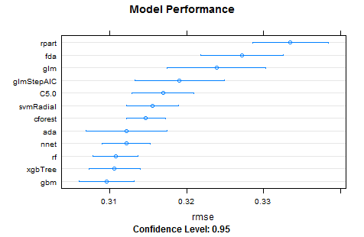
Several algorithms were used on the dataset after pre processing and rmse on the validation set was calculated each time. Linear models like logistic regression, linear SVM, xgboost linear performed poorly indicating that the problem is non-linear. However the liner model did help us spot good features. Tree based models gave the smallest rmse.
SUPERVISED LEARNING

Slide 25
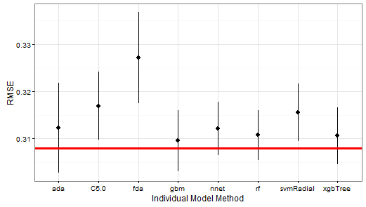
ENSEMBLE LEARNING
To increase robustness of the model an ensemble was created using weighted average. Ensemble was indeed robust and had lower rmse than each of the models individually as can be seen in the plot below. Red Line shows rmse of Ensemble model

Slide 26
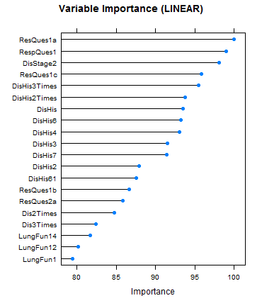
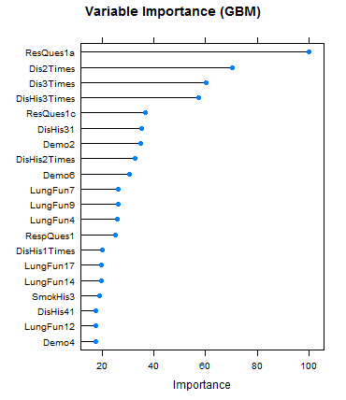
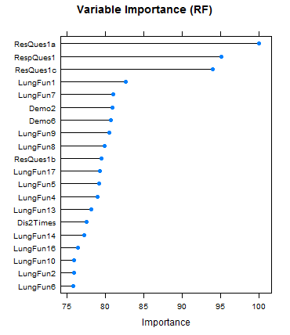
VARIABLE IMPORTANCE (MODELS)
Variable Importance according to linear , gradient boosted and forest models. These match with our initial bivariate and multivariate analysis.

Slide 27
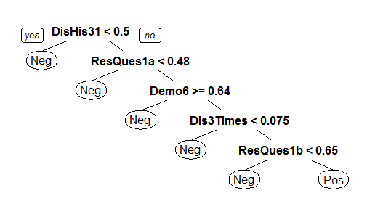
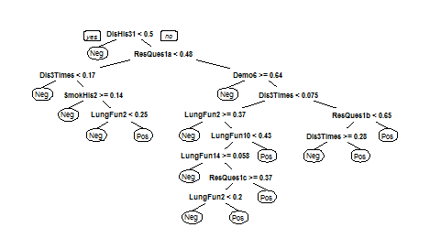
A very basic tree model makes its decision like shown below. This decision is somewhat consistent with our initial analysis. Bivariate analysis had pointed out that if DisHis3 is 0, odds of exacerbation is highly reduced.
VERY BASIC TREE
SLIGHTLY COMPLEX TREE
NOTE:DisHis3 was renamed to DisHis31 as it was converted into factor. Some other variables were renamed automatically too.

Slide 28
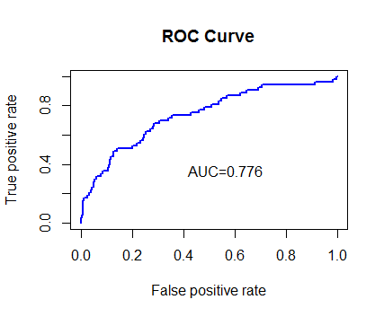
RESULTS ANALYSIS
On cross-validation set we achieved a maximum AUC of 0.776 and RMSE of 0.307. Adjusting the threshold we were able to obtain a sensitivity of 0.28 and a specificity of 0.95 which was impressive considering that we were able to raise alarm for 20% of the exacerbation patients without raising false alarms too often. This would definitely help in reducing healthcare costs significantly
OBS/PRED | EXACERBATOR | NON-EXACERBATOR
EXACERBATOR | 15 | 18
NON- EXCAERBATOR | 38 | 346
SENS = 0.28 SPEC = 0.95
ACCURACY = 0.8657

Slide 29
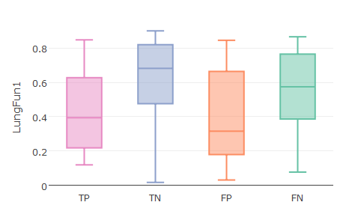
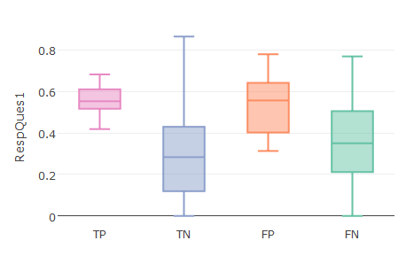
JUSTIFYING MIS-CLASSIFICATION
In the previous slide we see that the only thing hurting the analysis most is the large number of False Negatives. We performed an analysis to justify reasons for misclassification. We found that the almost important features had similar distributions for False Negatives and True Negatives and hence the misclassification occurred. Distributions of some of important features: RespQues1, Dis3Times, LungFun1, ResQues1c have been shown
SIMILAR DISTRIBUTIONS FOR TN AND FN

Slide 30
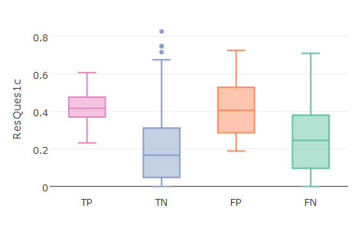
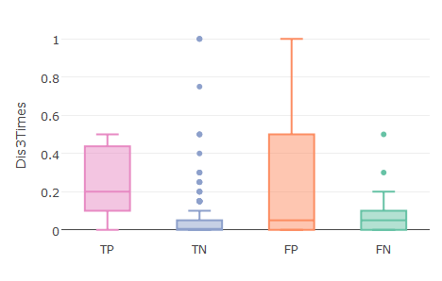
SIMILAR DISTRIBUTIONS FOR TN AND FN
While one reason of misclassification is the inability of variables to be discriminative enough, another reason is the less data available for training. Training dataset had only ~1300 rows, which might have proved to be insufficient for the problem.

Slide 31
CONCLUSION
Through this Case Study, we were able to identify the key variables that increase the chances of exacerbation in COPD patients and were able to develop a predictive model to predict the probability of exacerbation in COPD Patients
Sensitivity of 0.25 is fairly high for healthcare data keeping specificity grater than 0.95 (i.e. without raising false alarms) This meant that the model could correctly identify 25% of the COPD patients who are likely to develop exacerbation. Since Exacerbations of COPD lead to high costs in healthcare industry, predicting it beforehand would lead to reduced costs and also an improved quality of life for patients

